Slide 1
Introduction to Cybersecurity 2.1 Overview
April 2018

Slide 2


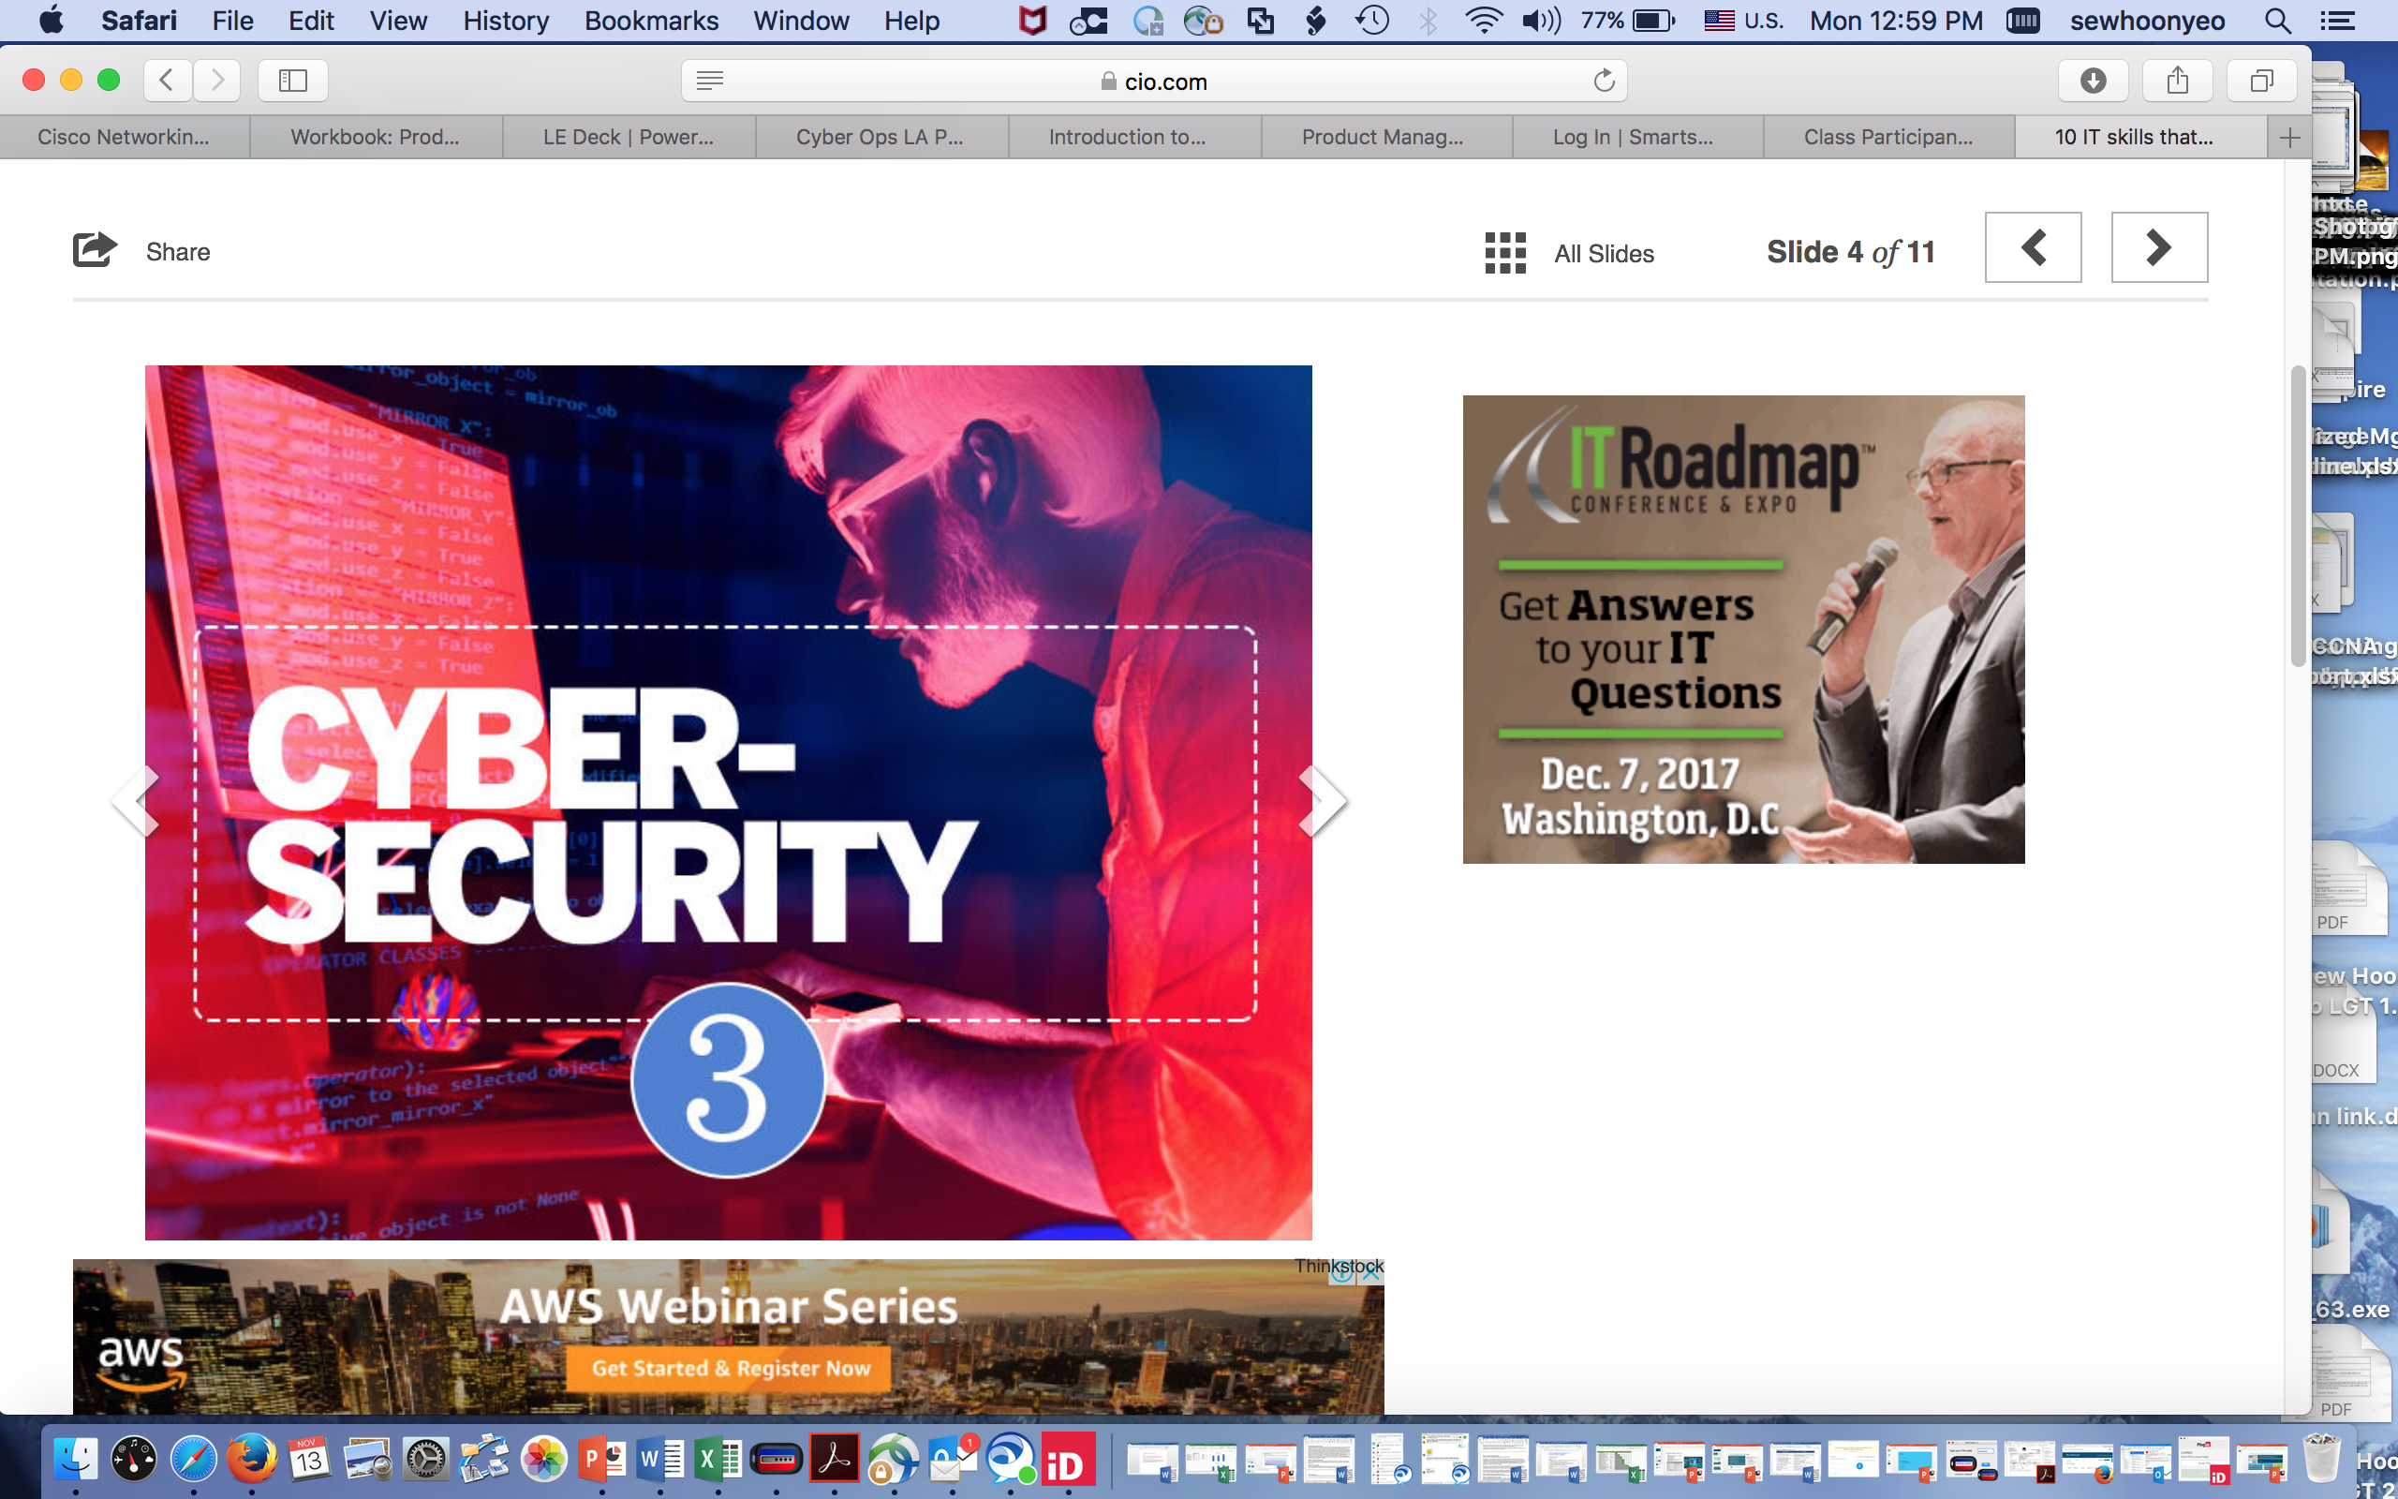
Why Cybersecurity?
Everyone Needs to Know
Skill Shortage
Hot Jobs
Even the grandmas on Facebook need to know and practice basic security hygiene, because what happens everywhere on the Internet can eventually affect us all.
A report from Frost & Sullivan and (ISC)² found that the global cybersecurity workforce will have more than 1.5 million unfilled positions by 2020.
10 IT skills that Employers need in 2017 – cybersecurity is rated top 3 skills that will be in high demand for 2017. Average salary for entry level jobs range from US$64k-$113k p.a.
Source: Why Cybersecurity Starts at Home
Source: report
Source: CIO from IDG , Indeed.com
Notes:
Firstly, Why is Security Hot? We have been hearing news of security breaches and attacks happening to both small and large organizations, including government agencies. It is almost a regular occurrence. The need for infosec and network security skills, and the resulting opportunities are tremendous. You can read in the slide; the hugh demand and job opportunities for security professionals in the market .

Slide 3
The Networking Academy Learning Portfolio
Current & Planned
Collaborate for Impact
Aligns to Certification
* Available within 12 months
Introduction to
Packet Tracer
Packet Tracer
Hackathons
Prototyping Lab
Internships
Instructor Training required
Self-paced
Exploratory
Foundational
Career-Ready
Networking Essentials
CCNA R&S: Introduction to Networks, R&S Essentials, Scaling Networks, Connecting Networks
Networking
Mobility Fundamentals
CCNP R&S: Switch, Route, TShoot
Emerging Tech Workshop: Network Programmability Using Cisco APIC-EM*
Security
Introduction to Cybersecurity
Cybersecurity Essentials
CCNA Security
CCNA Cyber Ops*
IoT & Analytics
Introduction to IoT
IoT Fundamentals:
Connecting Things, Big Data & Analytics Hackathon Playbook, IoT Security*
OS & IT
NDG Linux Unhatched
NDG Linux Essentials
NDG Linux I
IT Essentials
NDG Linux II
CLA: Programming Essentials in C
CLP: Advanced Programming in C*
CPA: Programming Essentials in C++
CPP: Advanced Programming in C++
Programming
PCA: Programming Essentials in Python*
Emerging Tech Workshop: Experimenting with REST APIs Using Cisco Spark*
Business
Be Your Own Boss
Entrepreneurship
Digital Literacy
Get Connected
October 2017
Notes:
In addition to traditional course offerings, the academy provides Collaborate for Impact events, tools, and opportunities
Collaborate for Impact are check-point experiences within the Foundational and Career-Ready offerings, but also independent events and offerings that serve to synthesize all skills learned to date in a problem-solving context.

Slide 4


Introduction to Cybersecurity
Course Overview
The Introduction to Cybersecurity course explores cyber trends, threats and staying safe in cyberspace, and protecting personal and company data.
Benefits
Learn how to protect your personal data and privacy online and in social media, and why more and more IT jobs require cybersecurity awareness and understanding.
Learning Components
Features
Target Audience: Secondary and 2-Year college students, general audience
Prerequisites: None
Instructor Training Required: No
Languages: Chinese-S, English (2.1), French, German, Hebrew, Italian, Japanese, Spanish, Portuguese
Course Delivery: Instructor-led or Self-paced
Estimated Time to Complete: 15 hours
5 modules
Interactive and instructional content
8 Activities and 7 lab exercises that reinforce learning
4 quizzes and 1 final exam
Links to related resources

Slide 5
Course Outline
Chapter | Chapter Titles | Summary Description
1 | The Need for Cybersecurity | Learn the need for and importance of cybersecurity. Understand the characteristics and value of personal data, and data within an organization.
2 | Attacks, Concepts and Techniques | Recognize the characteristics and operation of a cyber attack. Interpret the trends in the cyber threat landscape.
3 | Protecting Your Data and Privacy | Understand how to protect devices from threats. Master how to safeguard your privacy.
4 | Protecting the Organization | Learn techniques to protect organizations from cyber attacks. Recognize the behavior-based approach to cybersecurity. Explain Cisco’s approach to cybersecurity.
5 | Will Your Future Be in Cybersecurity? | Understand legal and ethical issues in cybersecurity Explore the opportunities for pursuing an education and a career in cybersecurity.

Slide 6

Module 1: The Need for Cybersecurity
Learn what cybersecurity is and why the demand for cybersecurity professionals is growing.
Module 1 presents:
What your online identity and data is, where it is, and why it is of interest to cyber criminals.
What organizational data is, and why it must be protected.
What cyber warfare is and why organizations, nations, and governments need cybersecurity professionals to protect their citizens and infrastructure.
Notes:
Use for vocational and 2- and 4-year college audiences
As IT and OT continue to merge, IoT jobs require deeper networking skills in addition to the foundation for Big Data and Analytics. We are confident that students who complete this technician level progression will already be in high demand, and will also be prepared to specialize in new high-demand IoT jobs such as industrial networking.

Slide 7
Module 2: Attacks, Concepts and Techniques
Learn how a cybersecurity professional analyzes a cyberattack.
Module 2 details:
Security vulnerabilities and the different types of vulnerabilities and malware.
The techniques used by attackers to infiltrate a system.
The characteristics and operation of a cyber attack.
The trends in the cyber threat landscape.
Notes:
Use for vocational and 2- and 4-year college audiences
As IT and OT continue to merge, IoT jobs require deeper networking skills in addition to the foundation for Big Data and Analytics. We are confident that students who complete this technician level progression will already be in high demand, and will also be prepared to specialize in new high-demand IoT jobs such as industrial networking.

Slide 8
Module 3: Protecting Your Data and Privacy
Become aware of your personal devices and data.
Module 3 covers:
Tips for protecting your personal devices and data by creating strong passwords and using wireless networks safely.
Authentication techniques helping you maintain your data securely with tips about what to do and what not to do online.
Protecting devices from threats.
Safeguarding your privacy.
Notes:
Use for vocational and 2- and 4-year college audiences
As IT and OT continue to merge, IoT jobs require deeper networking skills in addition to the foundation for Big Data and Analytics. We are confident that students who complete this technician level progression will already be in high demand, and will also be prepared to specialize in new high-demand IoT jobs such as industrial networking.

Slide 9
Module 4: Protecting The Organization
Learn about the technologies, processes, and best practices used when protecting an organization’s network.
Module 4 presents:
Equipment, data, and the commonly used security terms such as botnets, the kill chain, and behavior-based security.
Cisco’s approach to cybersecurity using a CSIRT team and a security playbook.
Techniques for protecting organizations from cyber attacks.
The behavior-based approach to cybersecurity.
Cisco’s approach to cybersecurity.
Notes:
Use for vocational and 2- and 4-year college audiences
As IT and OT continue to merge, IoT jobs require deeper networking skills in addition to the foundation for Big Data and Analytics. We are confident that students who complete this technician level progression will already be in high demand, and will also be prepared to specialize in new high-demand IoT jobs such as industrial networking.

Slide 10
Module :5 Will Your Future Be in Cybersecurity?
Explore educational paths towards certifications with the Cisco Networking Academy (NetAcad).
Module 5 summarizes:
Understand legal and ethical Issues in Cybersecurity
Explore the opportunities for pursuing an education and a career in cybersecurity.
Notes:
Use for vocational and 2- and 4-year college audiences
As IT and OT continue to merge, IoT jobs require deeper networking skills in addition to the foundation for Big Data and Analytics. We are confident that students who complete this technician level progression will already be in high demand, and will also be prepared to specialize in new high-demand IoT jobs such as industrial networking.

